Slide 1
“THE MILLENNIALS”
Guide:
Assistant Prof. Dhaval Bhoi
Prepared by:
Prachi Desai (22CE025)
Smit Gandhi (22CE031)
Dhruvil Joshi (22CE044)

Slide 2
TABLE OF CONTENTS
About the project……………………………………………………………………………………3
Description of our project
Technologies………………………………………………………………………………………...4
Technologies used
Why The Millennials?………………………………………………………………………………5
Logo of the website
Features of website
Demonstration……………………………………………………………………………………….8
Project website
Gameplay

Slide 3
ABOUT THE PROJECT
This is a web development project of a Gaming website(online free games simulator)
“The Millennials” aims to display childhood on digital platform
This website allow users to experience their childhood games with a pinch of tech which gives them feeling of nostalgia and despite being any age they can recall their good old days.
It contains various games having their own extra elements as well as maintains it’s own ethinicity.

Slide 4
TECHNOLOGIES
The languages used in creating, designing and making our website user-interactive are:
HTML (HyperText Markup Language) : To create skeleton of website
CSS (Cascading Style Sheets) : To design and animate webpage
JavaScript : To make the website user-friendly and add various functions to it

Slide 5


Why The Millennials?

Slide 6
FEATURES
Nostalgic
Mind-Refreshing
Responsive Design
Easy Navigation
Appealing UI and UX
Updates with regular interval

Slide 7
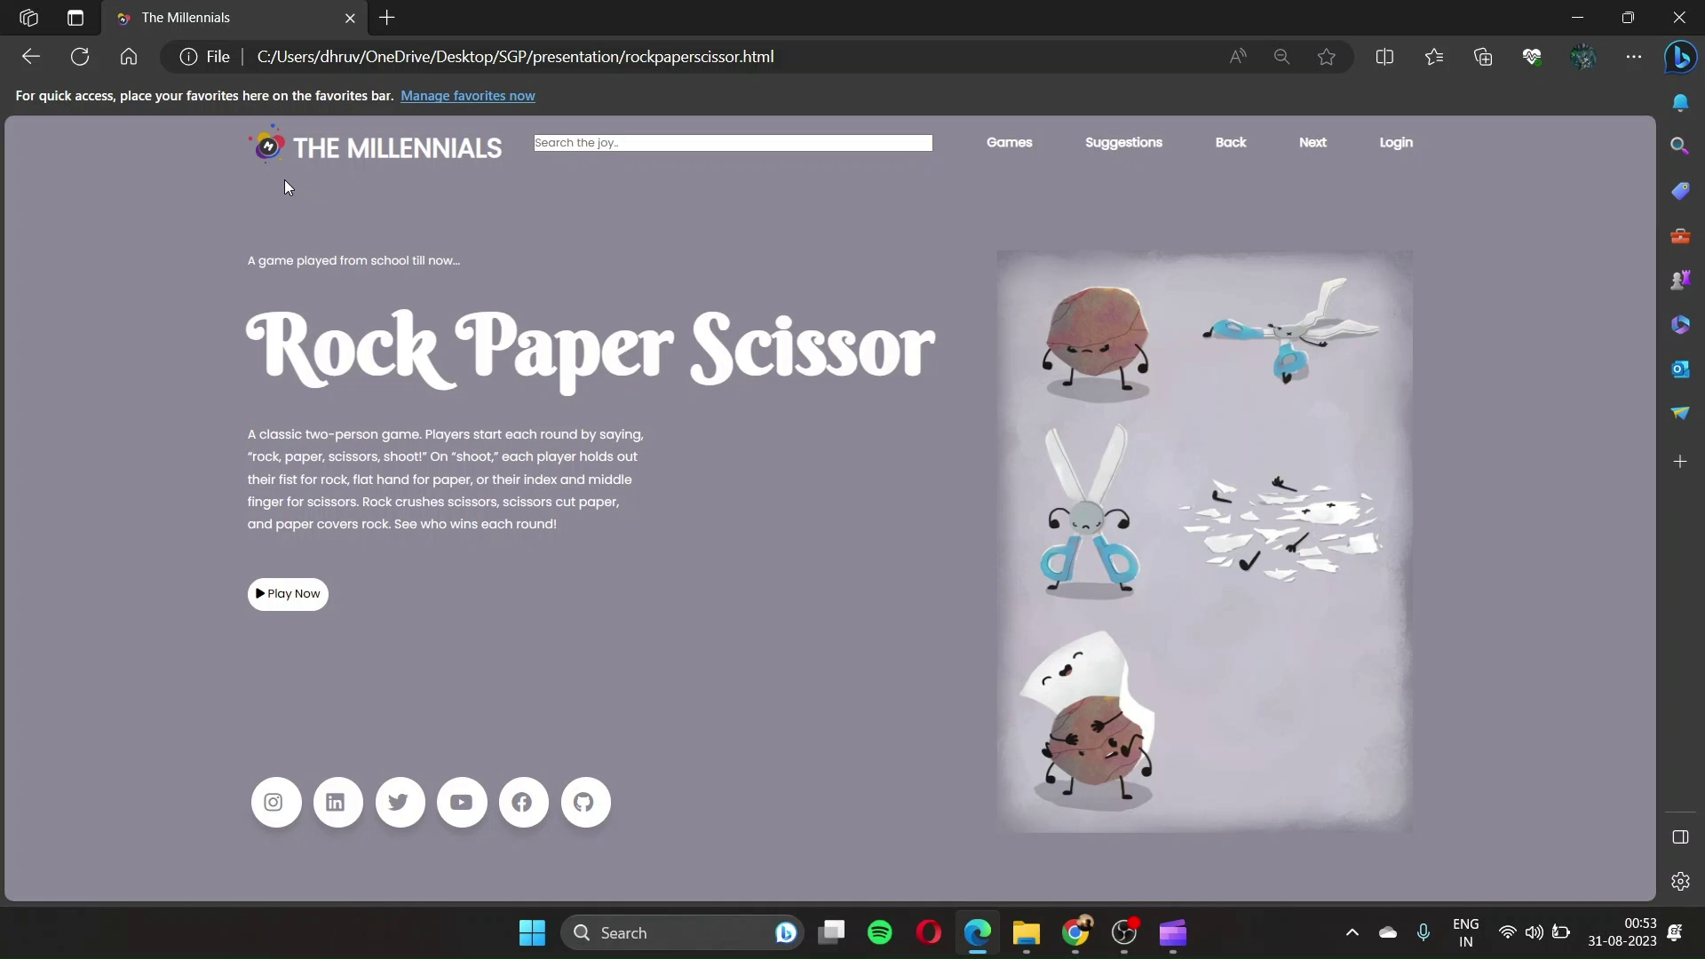
PROLOGUE

Slide 8

ROCK PAPER SCISSOR

Slide 9
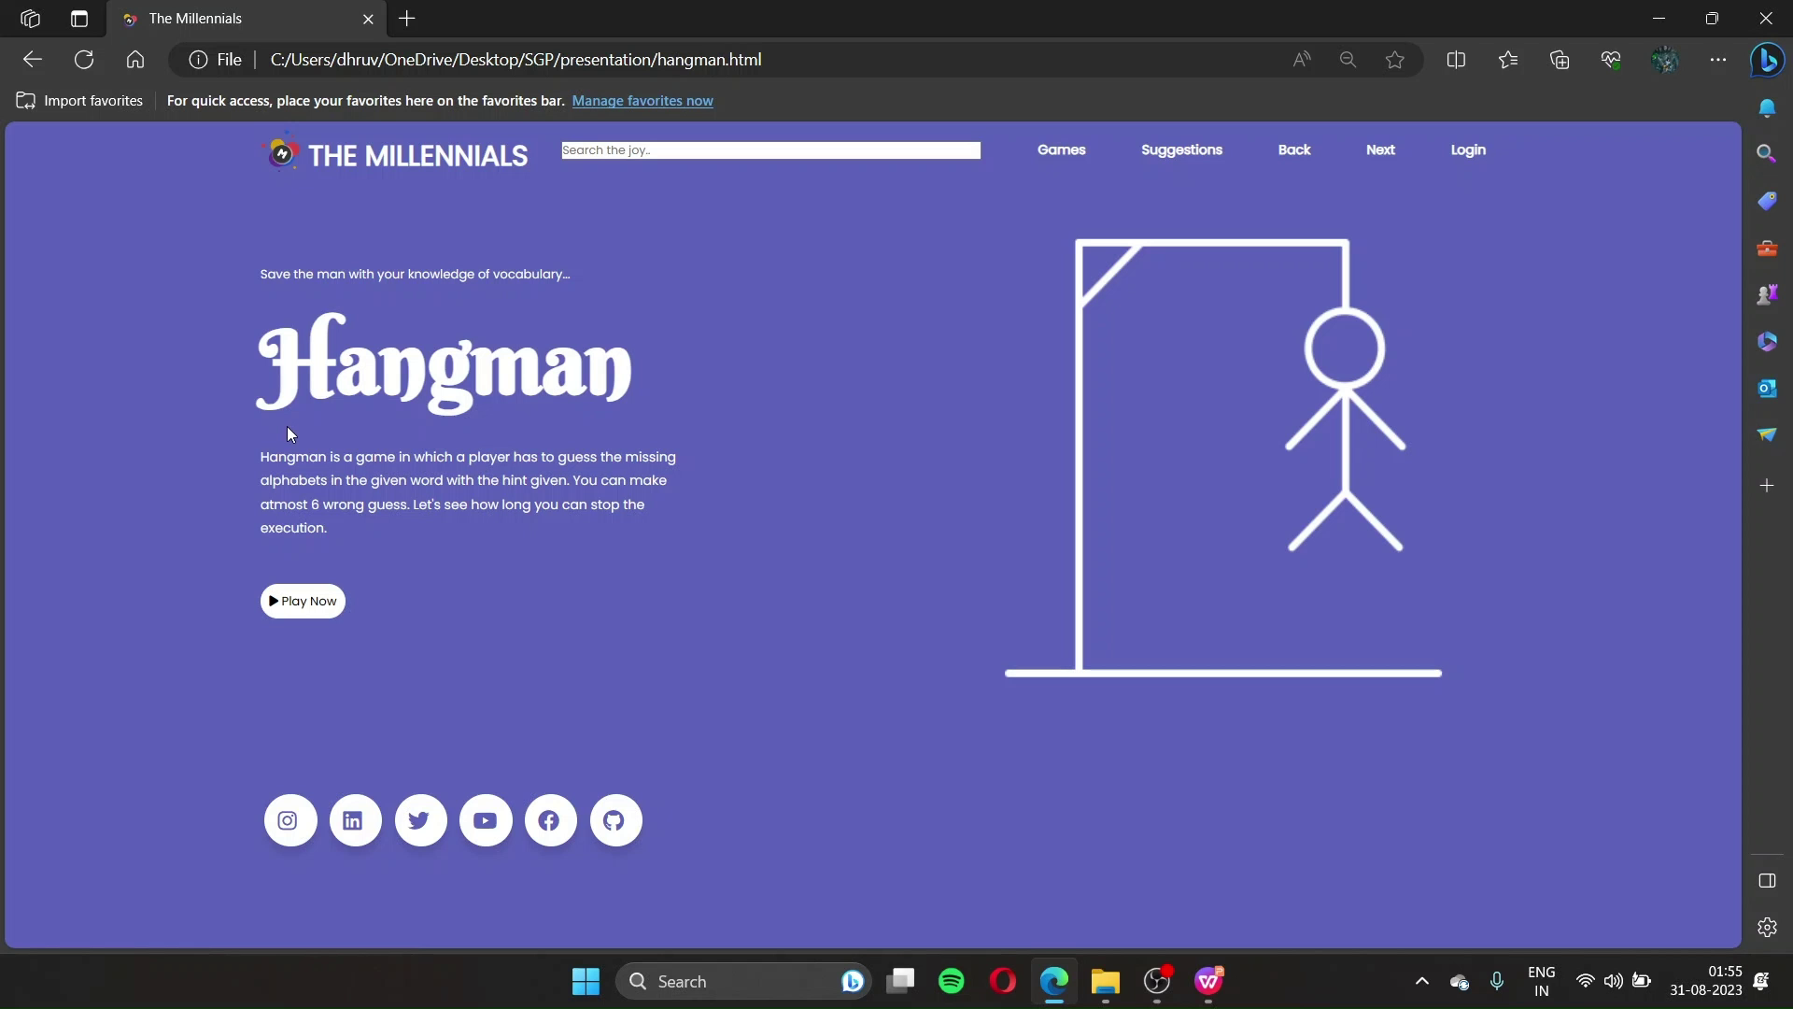
HANGMAN

Slide 10
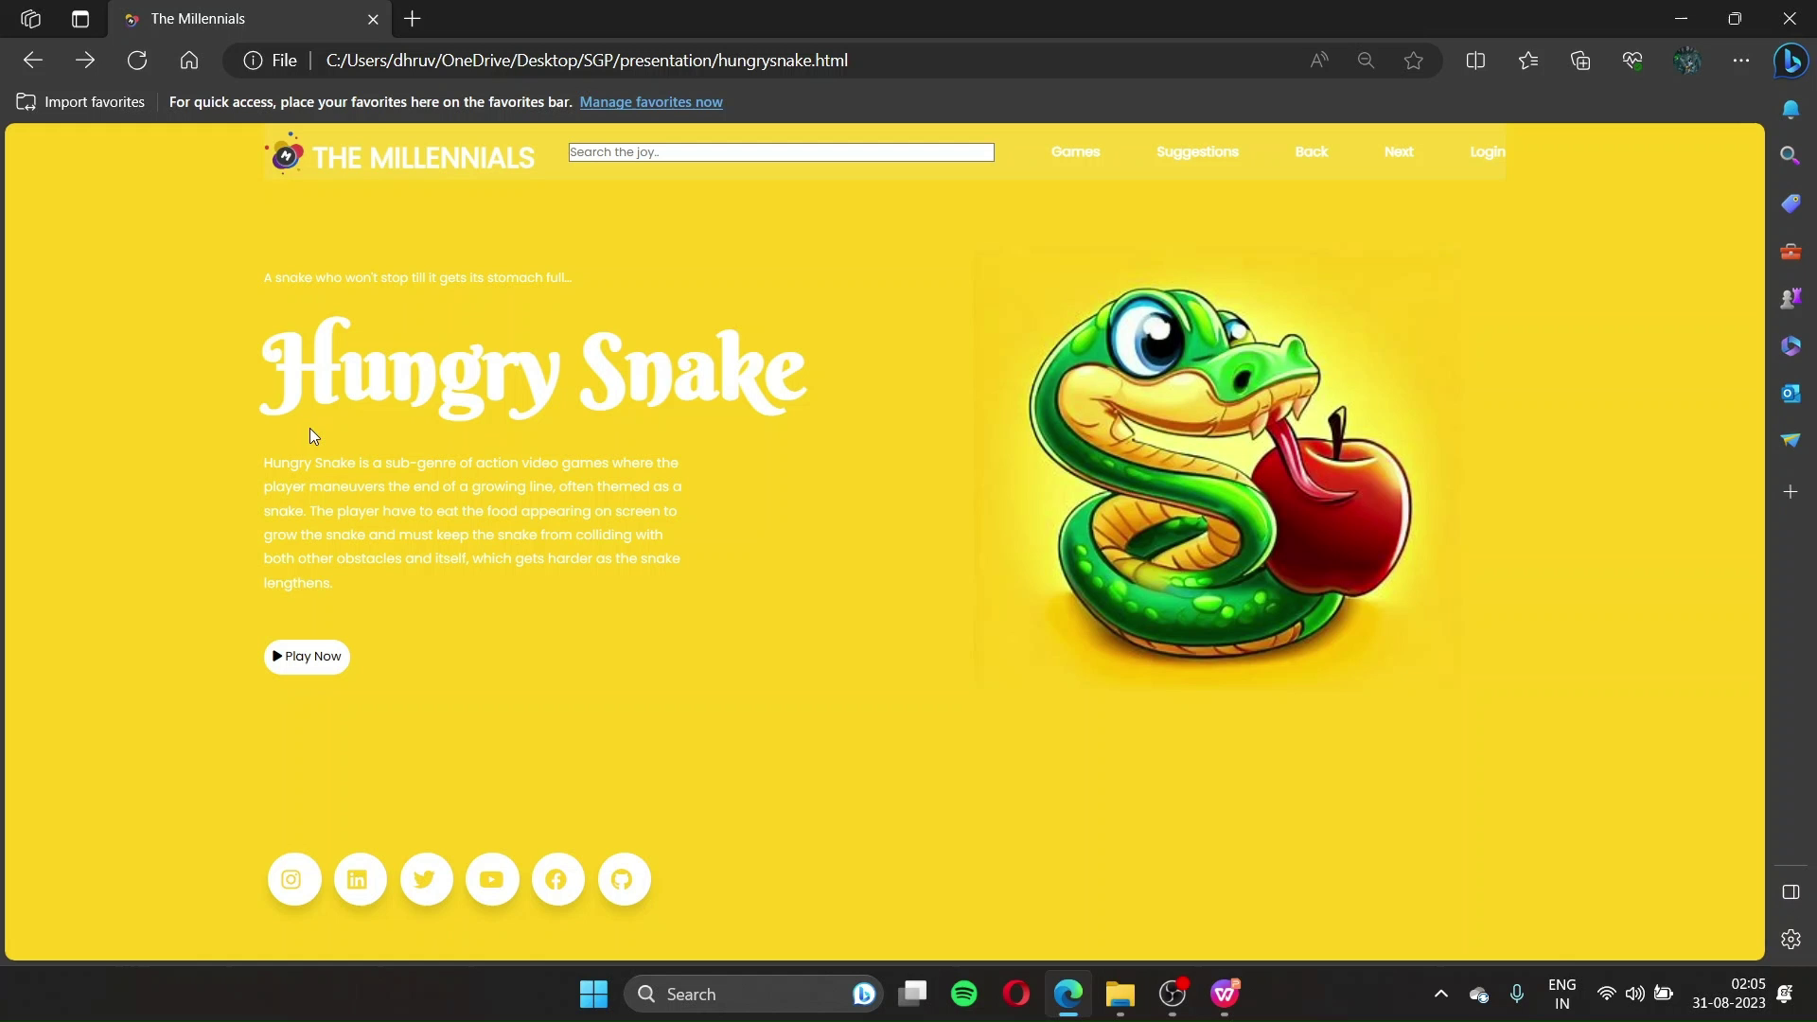
HUNGRY SNAKE

Slide 11
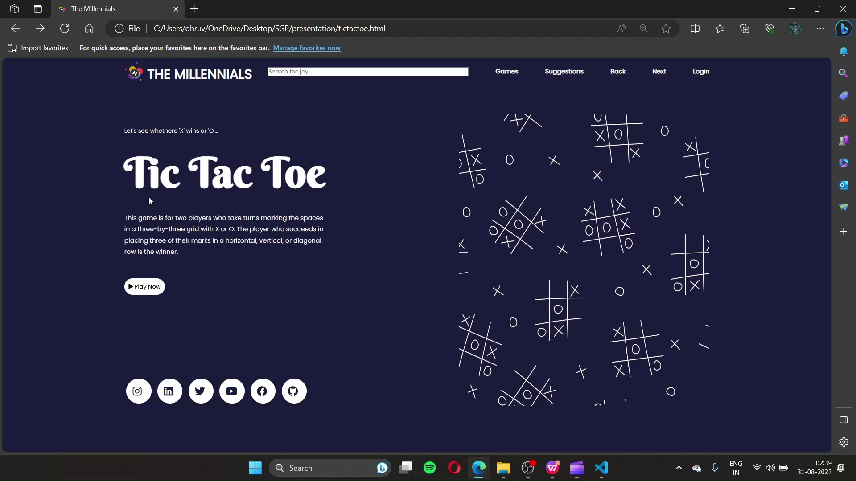
TIC TAC TOE

Slide 12
THANK YOU

